Slide 1
Decision Trees

Slide 2
Learning Goals
In this section, we will cover:
- Overview of Classification problems
- Decision Tree Classification algorithm
- Splitting Decision Trees: entropy and information gain
- Pruning Decision Trees to address overfitting

Slide 3
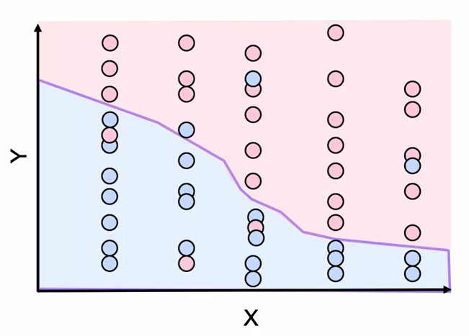
Overview of Classifier Characteristics
• For K-Nearest Neighbors, training data is the model.
• Fitting is fast - just store data.
• Prediction can be slow - lots of distances to measure.
•Decision boundary is flexible.

Slide 4
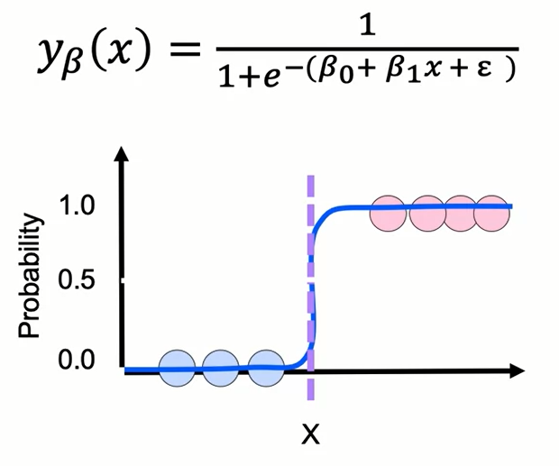
Overview of Classifier Characteristics
• For logistic regression, model is just parameters.
• Fitting can be slow - must find best parameters.
• Prediction is fast - calculate expected value.
• Decision boundary is simple, less flexible.

Slide 5
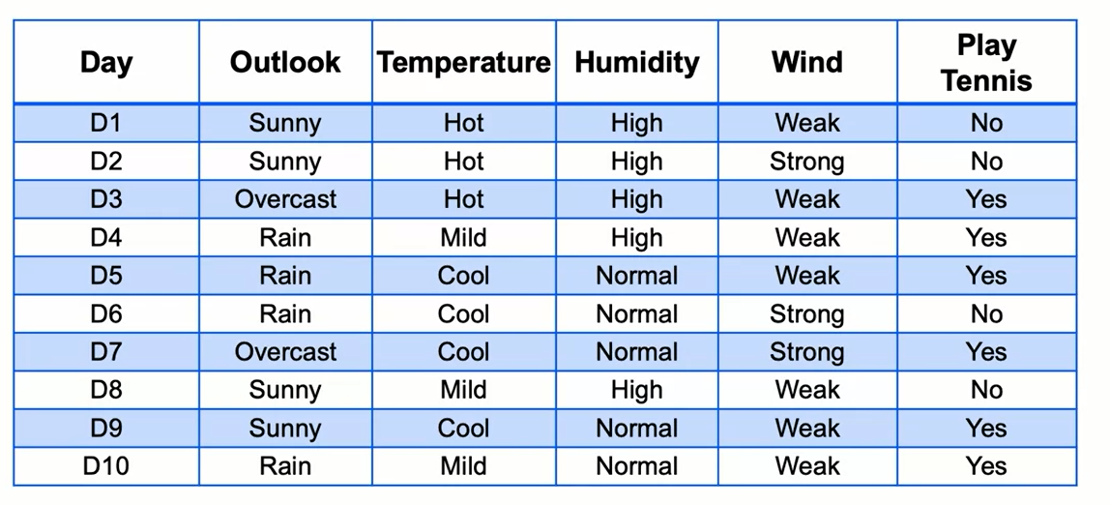
Classification application
As the administrator for a tennis facility, understand drivers of customer turnout

Slide 6
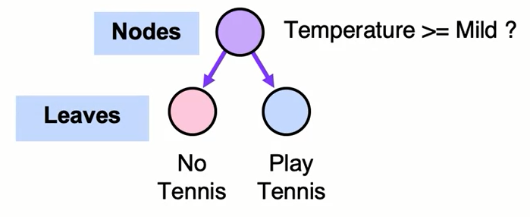
Introduction to Decision Trees
- Want to predict whether customers will play tennis based on temperature, humidity, wind, outlook.
- Segment data based on features to predict result.

Slide 7
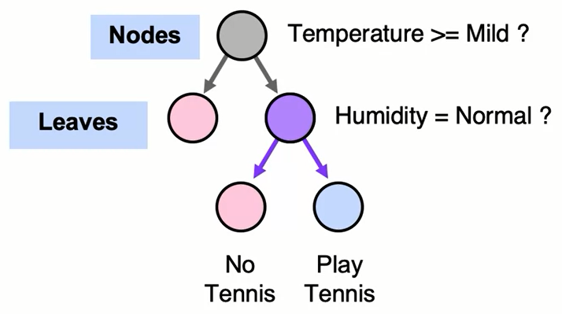
Introduction to Decision Trees
- Want to predict whether customers will play tennis based on temperature, humidity, wind, outlook.
- Segment data based on features to predict result.
- Trees that predict categorical results are decision trees

Slide 8
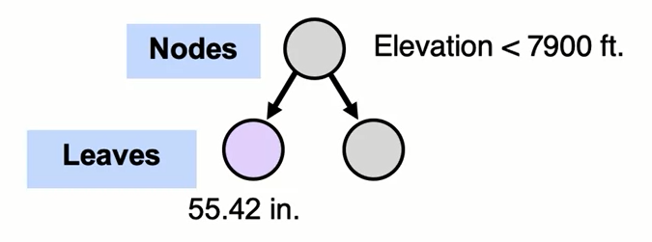
Trees Predict Continuous Values
- Example: use slope and elevation in Himalayas.
- Predict average precipitation (continuous value).

Slide 9
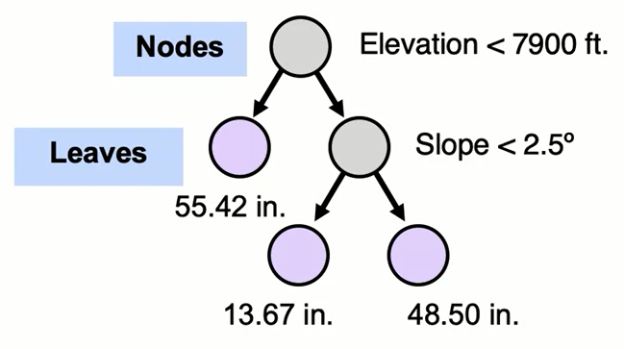
Trees Predict Continuous Values
- Example: use slope and elevation in Himalayas.
- Predict average precipitation (continuous value).
- Values at leaves are averages of members.

Slide 10
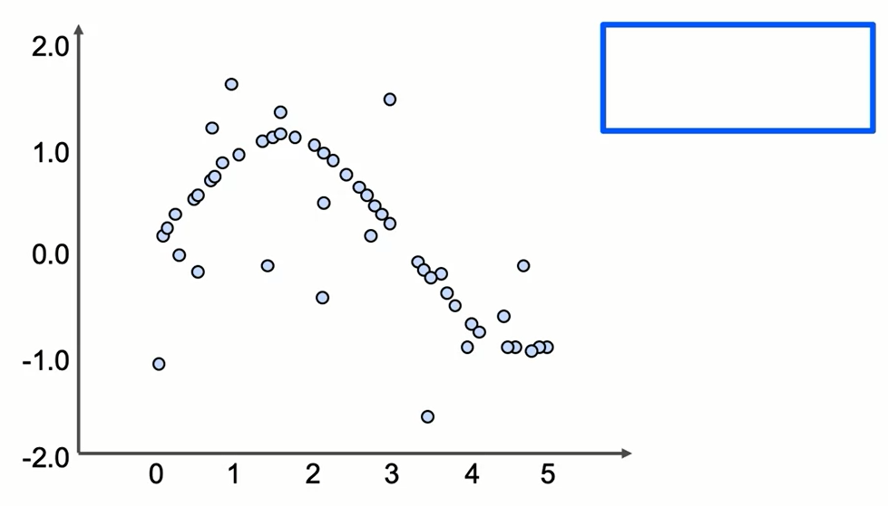
Trees Predict Continuous Values

Slide 11
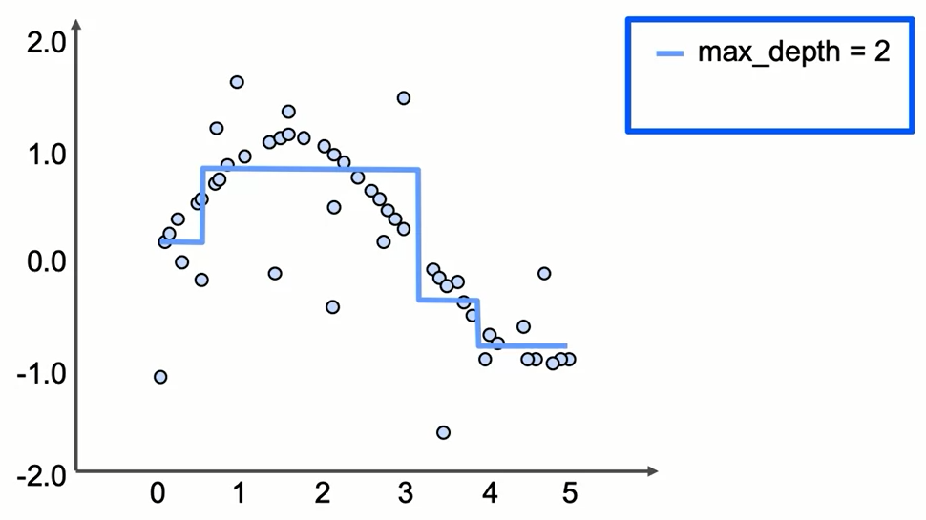
Trees Predict Continuous Values

Slide 12
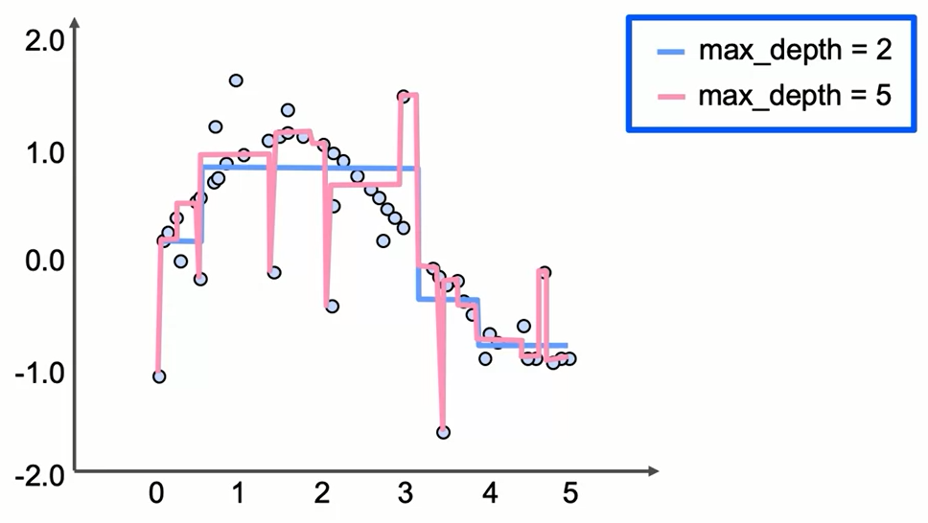
Trees Predict Continuous Values

Slide 13
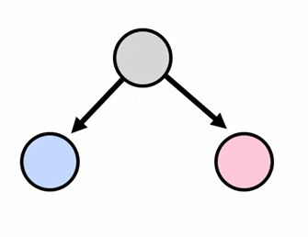
Building a Decision Tree
- Select a feature and split data into binary tree.

Slide 14
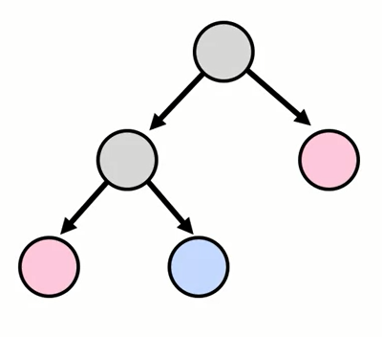
Building a Decision Tree
- Select a feature and split data into binary tree.
- Continue splitting with available features.

Slide 15
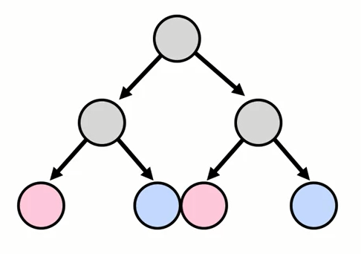
Building a Decision Tree
- Select a feature and split data into binary tree.
- Continue splitting with available features.

Slide 16
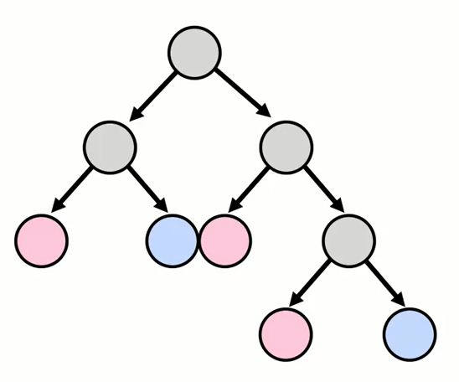
How Long to Keep Splitting?
Until:
- Leaf node(s) are pure
(only one class remains).
- A maximum depth is reached.
- A performance metric is achieved.

Slide 17
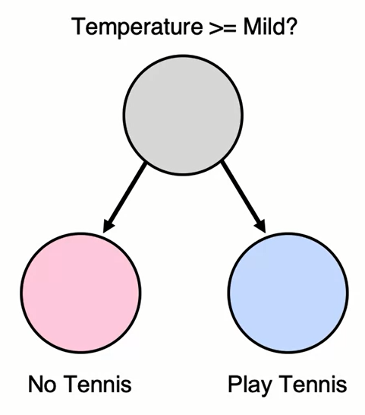
Building the Best Decision Tree
- Use greedy search: find the best split at each step.
- What defines the best split?
- One that maximizes the information gained from the split.
- How is information gain defined?

Slide 18
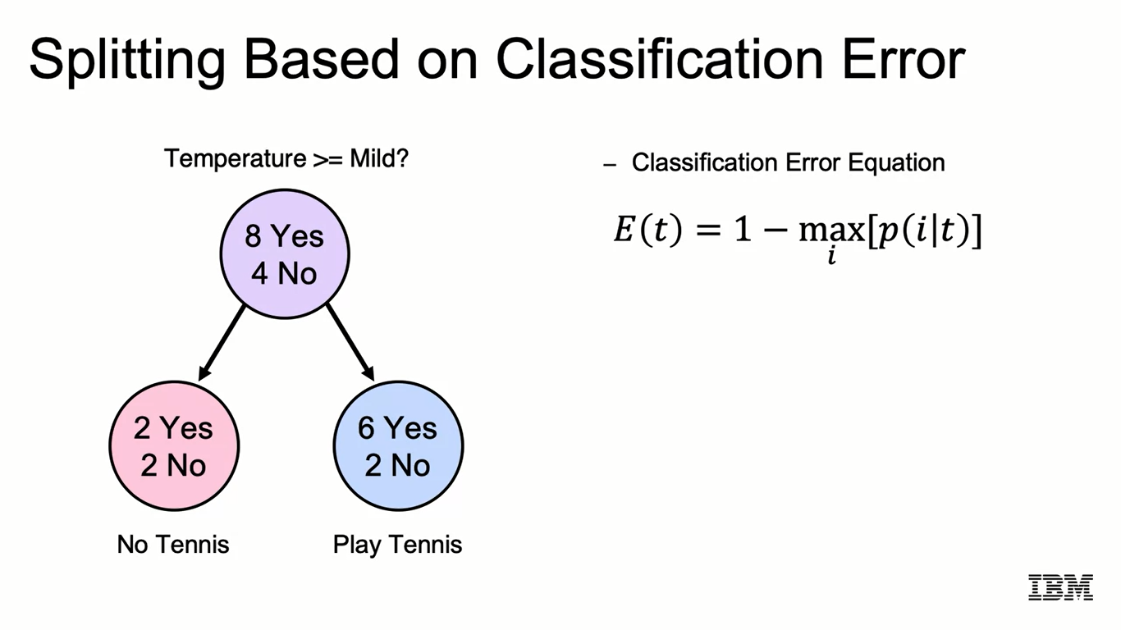
Splitting Based on Classification Error

Slide 19
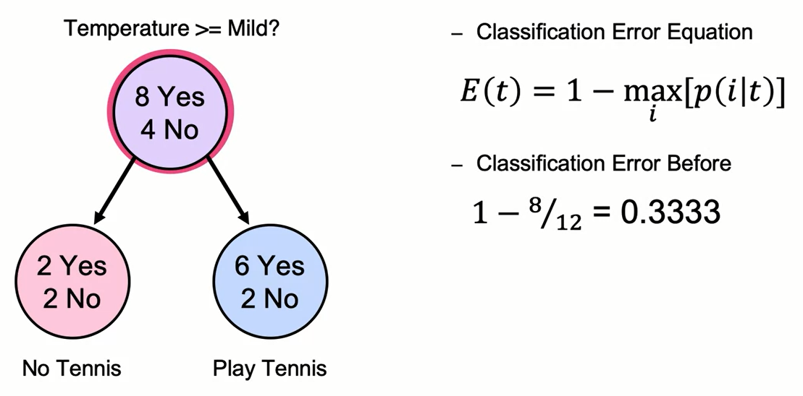
Splitting Based on Classification Error

Slide 20
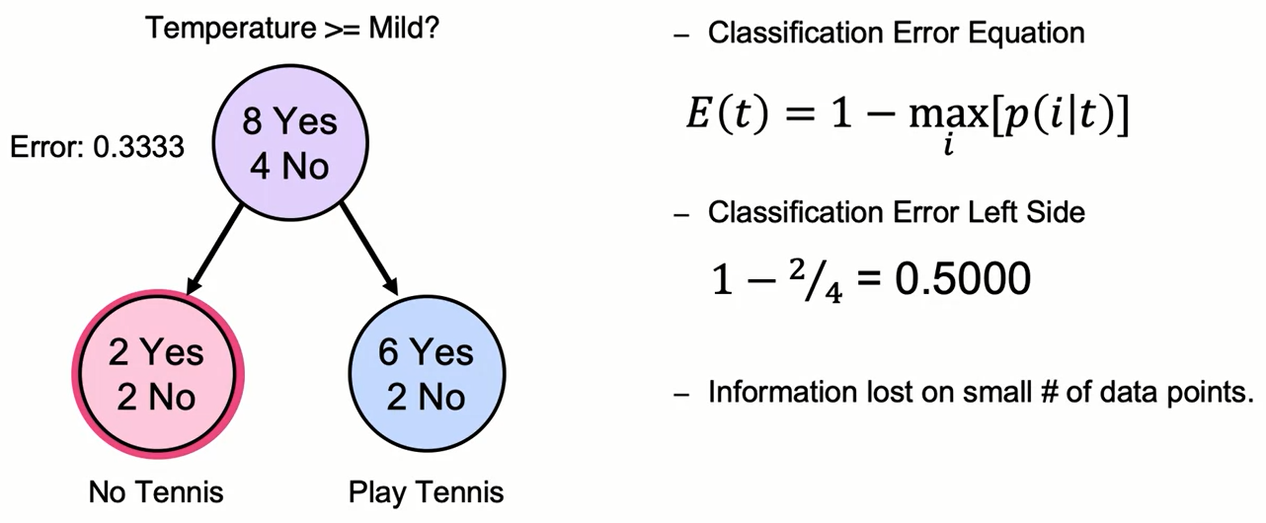
Splitting Based on Classification Error

Slide 21
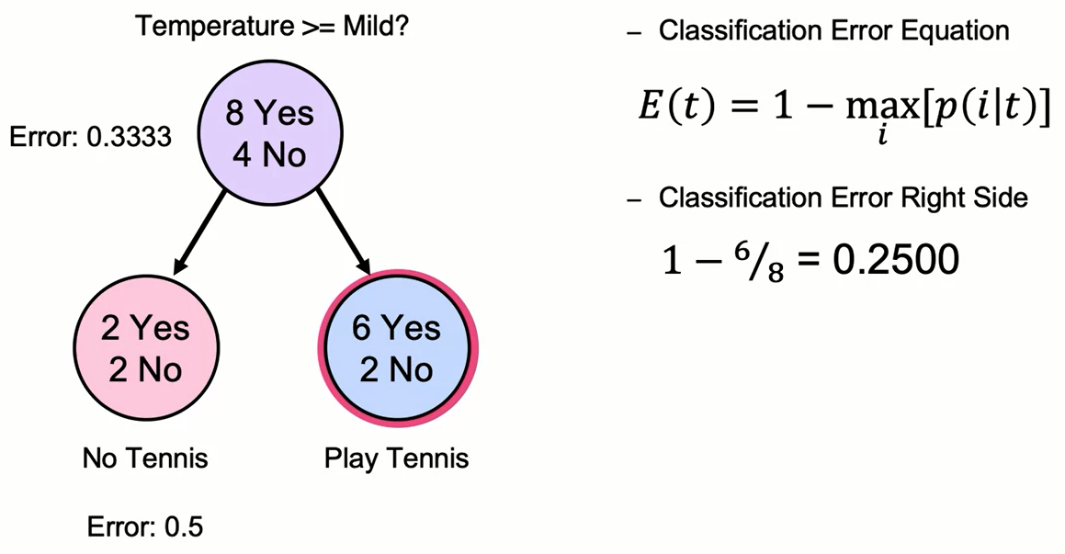
Splitting Based on Classification Error

Slide 22
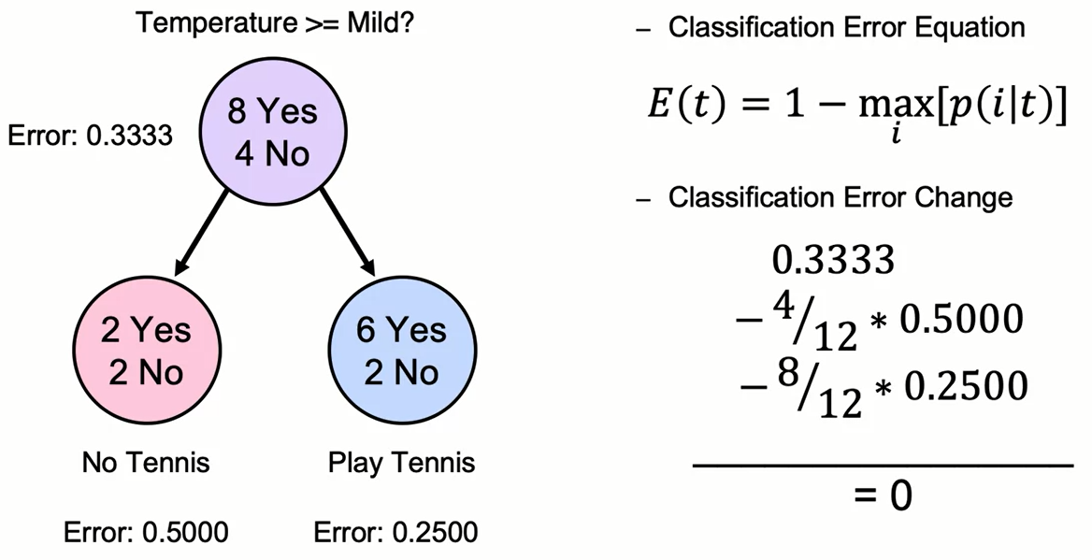
Splitting Based on Classification Error

Slide 23
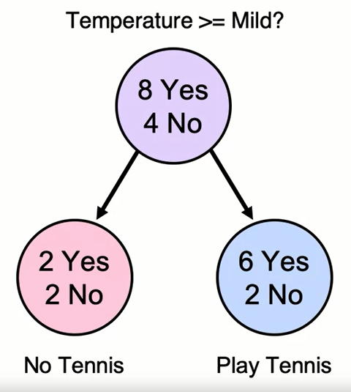
Splitting Based on Classification Error
- Using classification error, no further splits would occur.
- Problem: end nodes are not homogeneous.
- Try a different metric?

Slide 24
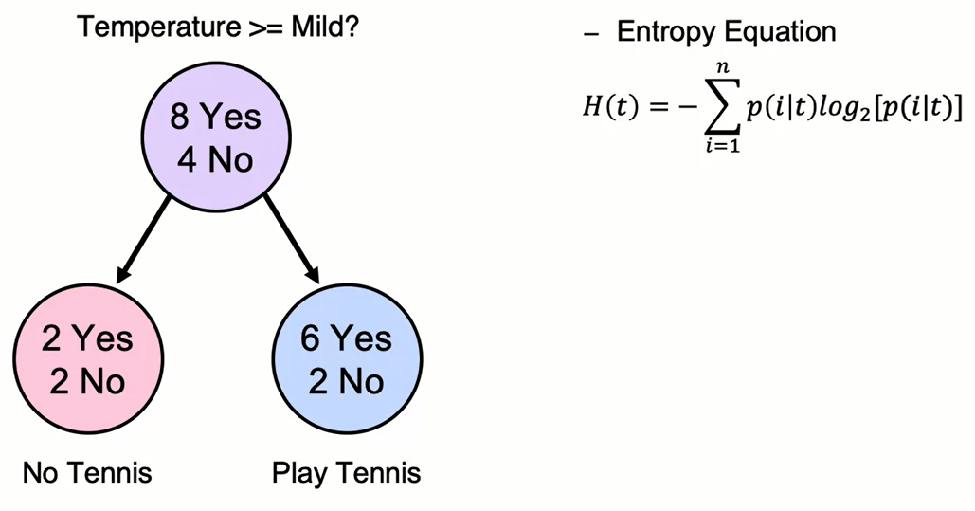
Splitting Based on Entropy

Slide 25
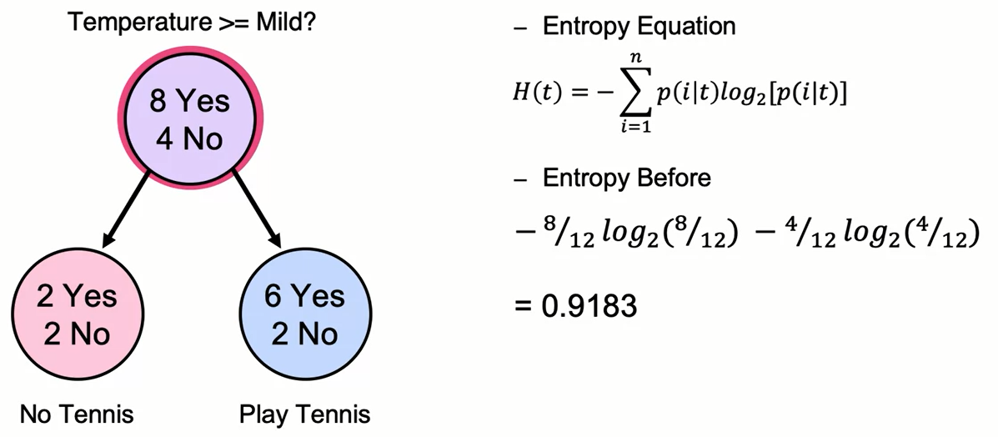
Splitting Based on Entropy

Slide 26
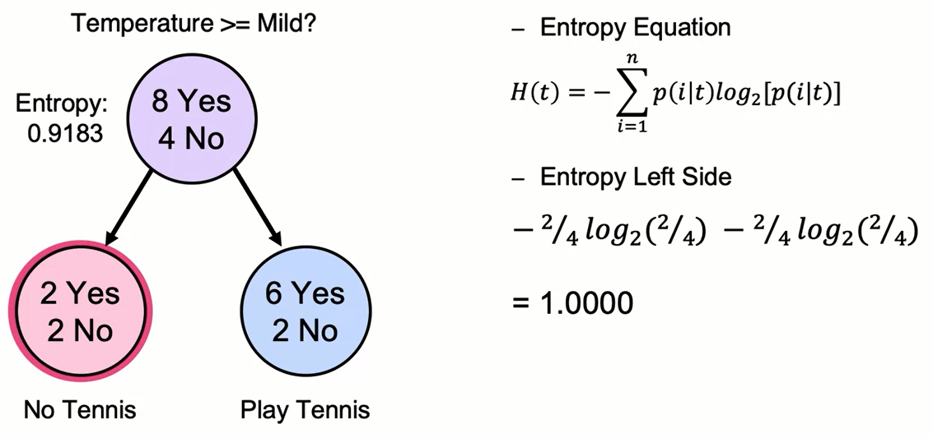
Splitting Based on Entropy

Slide 27
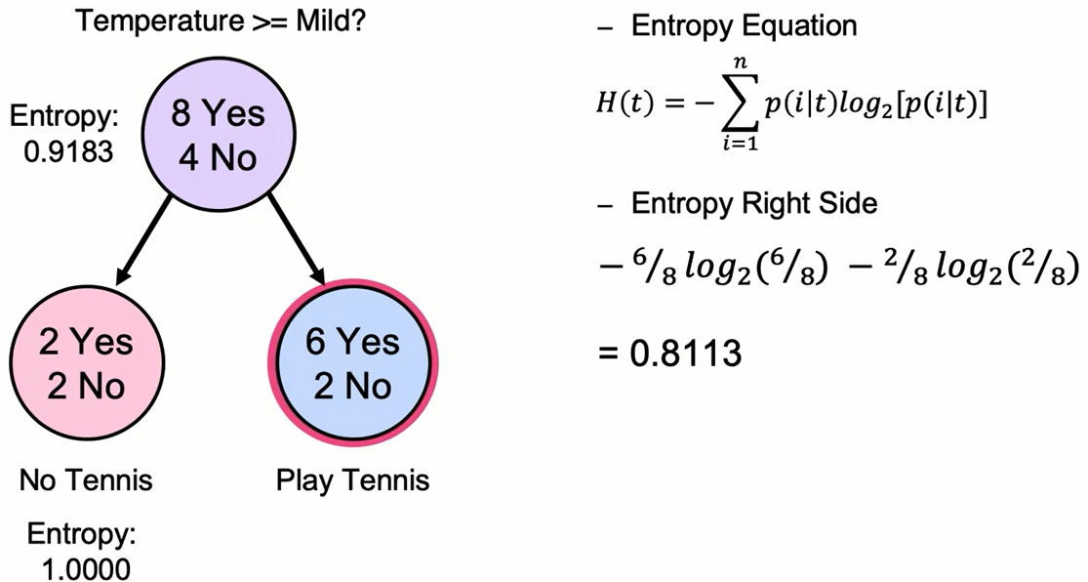
Splitting Based on Entropy

Slide 28
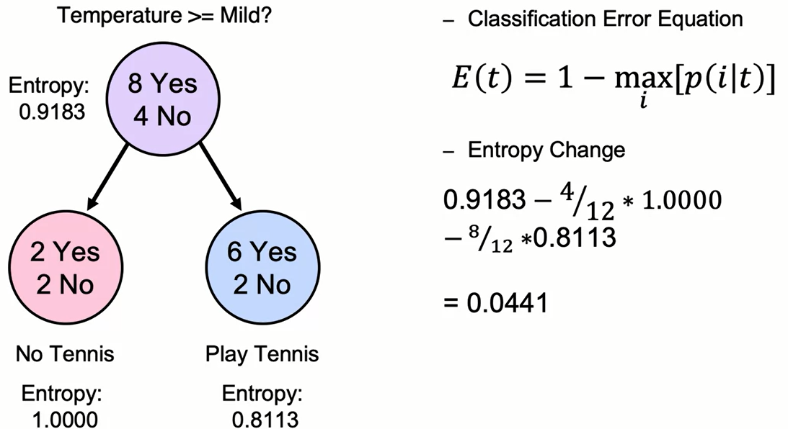
Splitting Based on Entropy

Slide 29
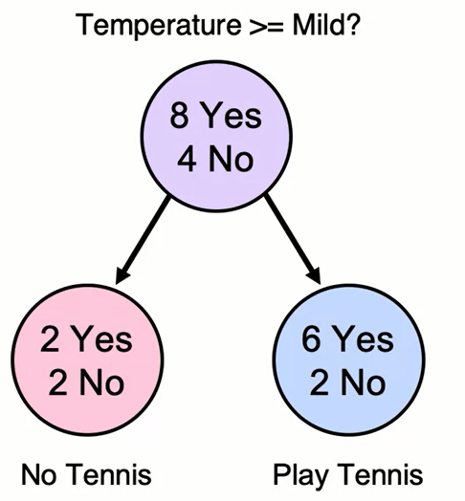
Splitting Based on Entropy
- Splitting based on entropy allows further splits to occur.
- Can eventually reach goal of homogeneous nodes.
- Why does this work with entropy but not classification error?

Slide 30
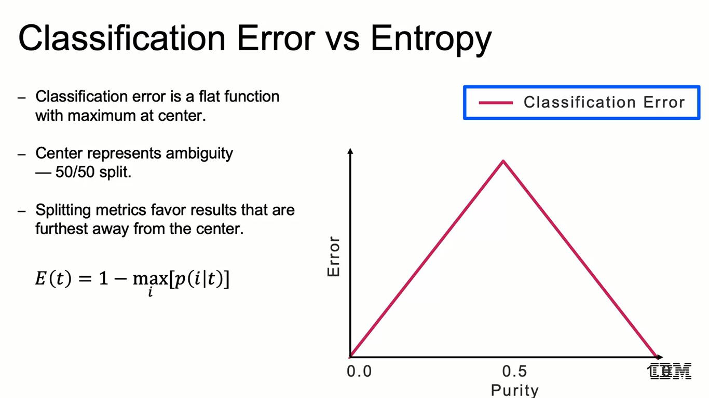
Classification Error vs Entropy
- Classification error is a flat function with maximum at center.
- Center represents ambiguity - 50/50 split.
- Splitting metrics favor results that are furthest away from the center.

Slide 31
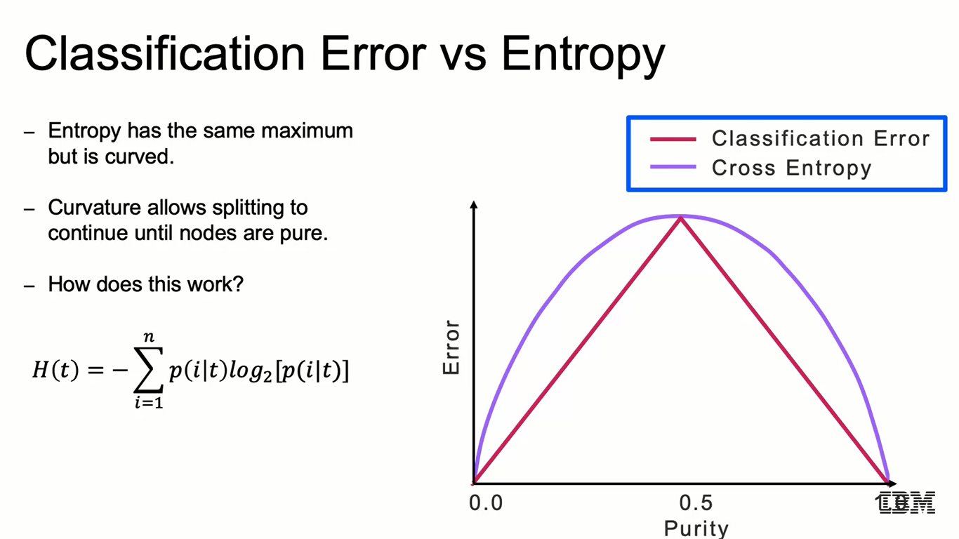
Classification Error vs Entropy
- Entropy has the same maximum but is curved.
- Curvature allows splitting to continue until nodes are pure.
- How does this work?

Slide 32
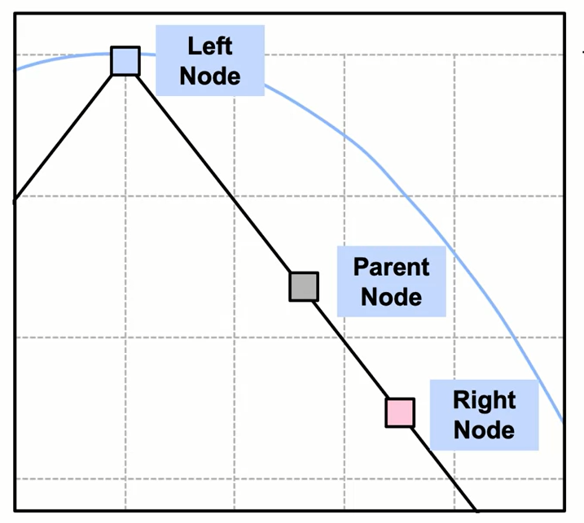
Information Gained by Splitting
- With classification error, the function is flat.

Slide 33
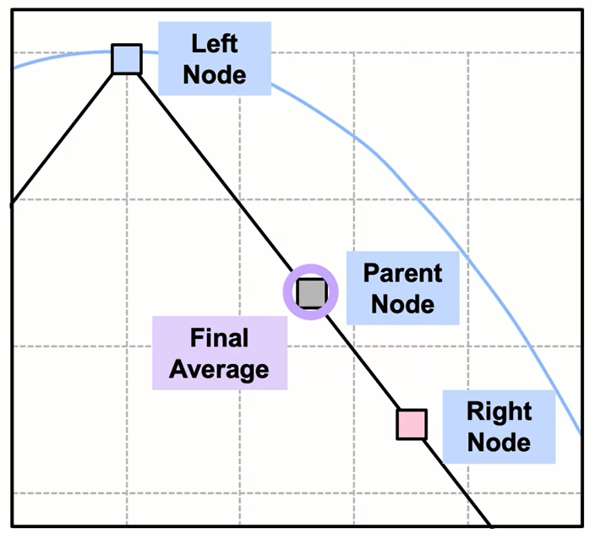
Information Gained by Splitting
- With classification error,
the function is flat.
- Final average classification error can be identical to parent.
- Resulting in premature stopping.

Slide 34
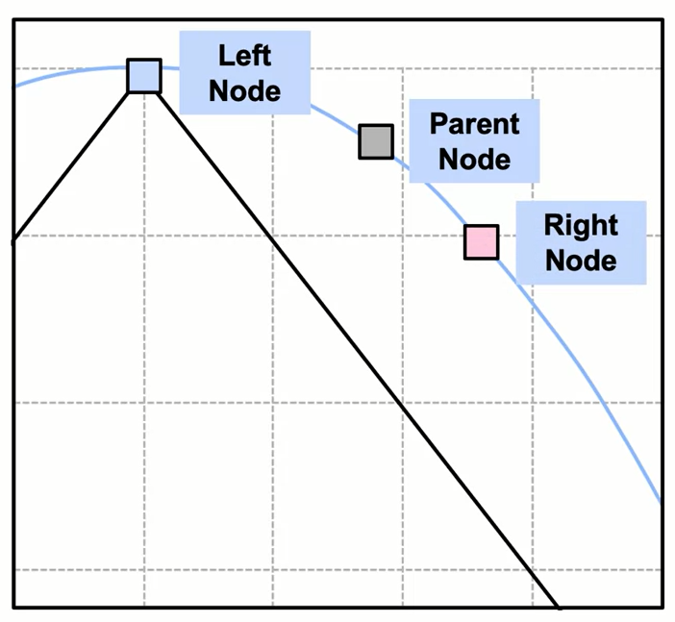
Information Gained by Splitting
- With entropy gain, the function has a "bulge”.

Slide 35
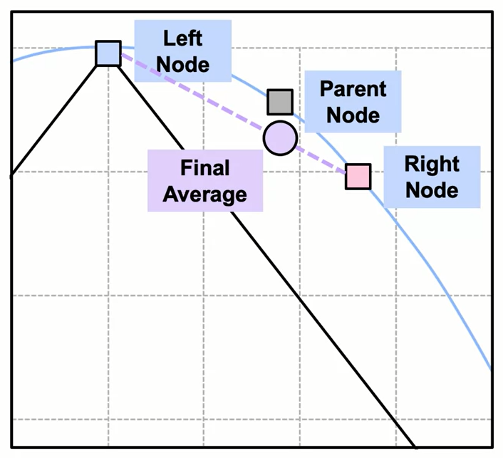
Information Gained by Splitting
- With entropy gain, the function has a "bulge”.
- Allows average information of children to be less than parent.
- Results in information gain and continued splitting.

Slide 36
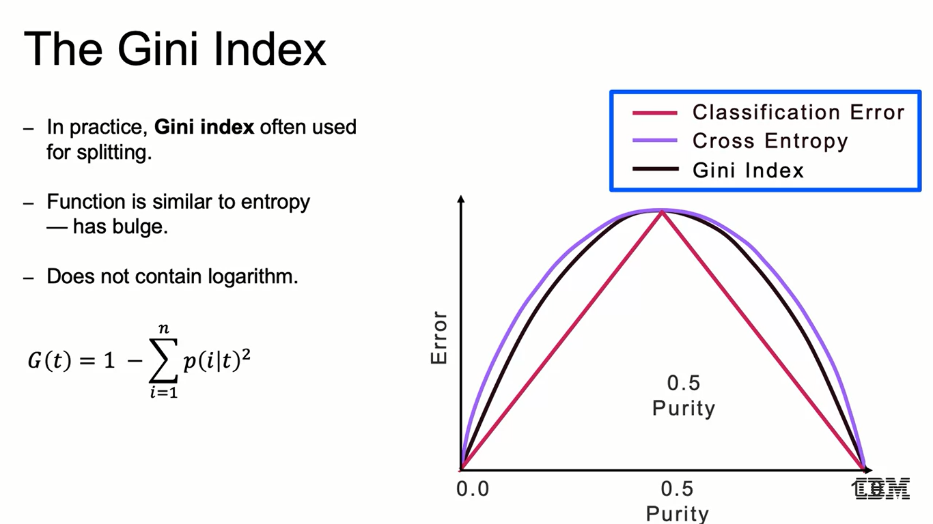
The Gini Index
- In practice, Gini index often used for splitting.
- Function is similar to entropy - has bulge.
- Does not contain logarithm.

Slide 37
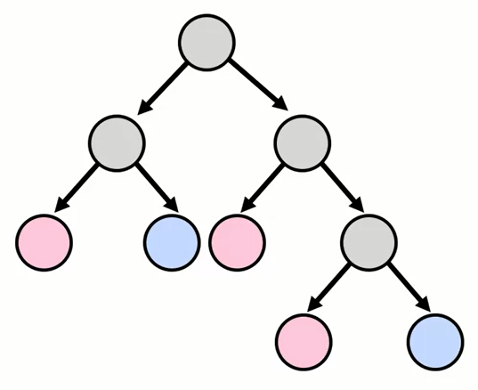
Decision Trees are High Variance
- Problem: decision trees tend to overfit.
- Small changes in data greatly affect prediction - high variance.
- Solution: Prune trees.

Slide 38
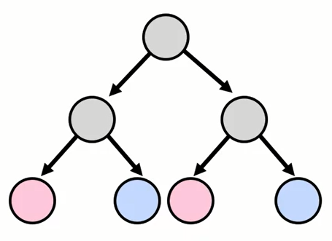
Decision Trees are High Variance
- Problem: decision trees tend to overfit.
- Small changes in data greatly affect prediction - high variance.
- Solution: Prune trees.

Slide 39
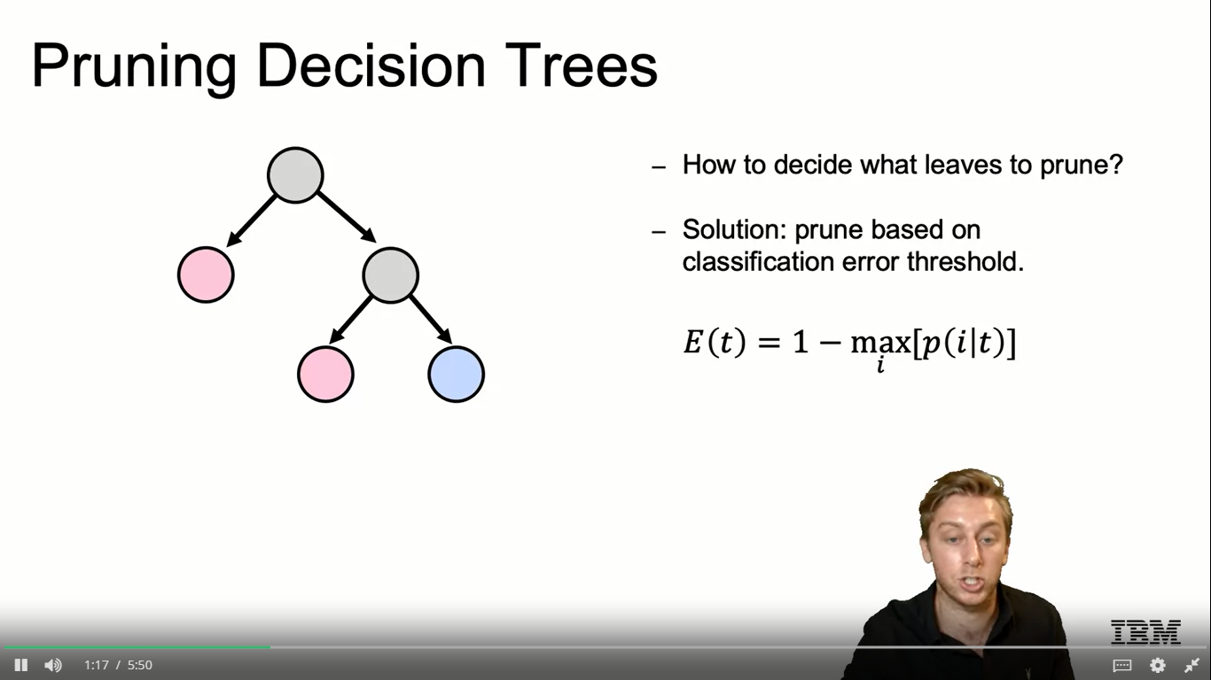
Pruning Decision Trees
- How to decide what leaves to prune?
- Solution: prune based on classification error threshold.

Slide 40
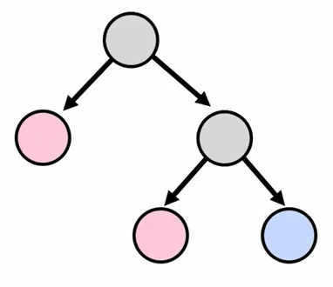
Strengths of Decision Trees
- Easy to interpret and implement
— "if ... then ... else" logic.
- Handle any data category
— binary, ordinal, continuous.
- No preprocessing or scaling required.

Slide 41
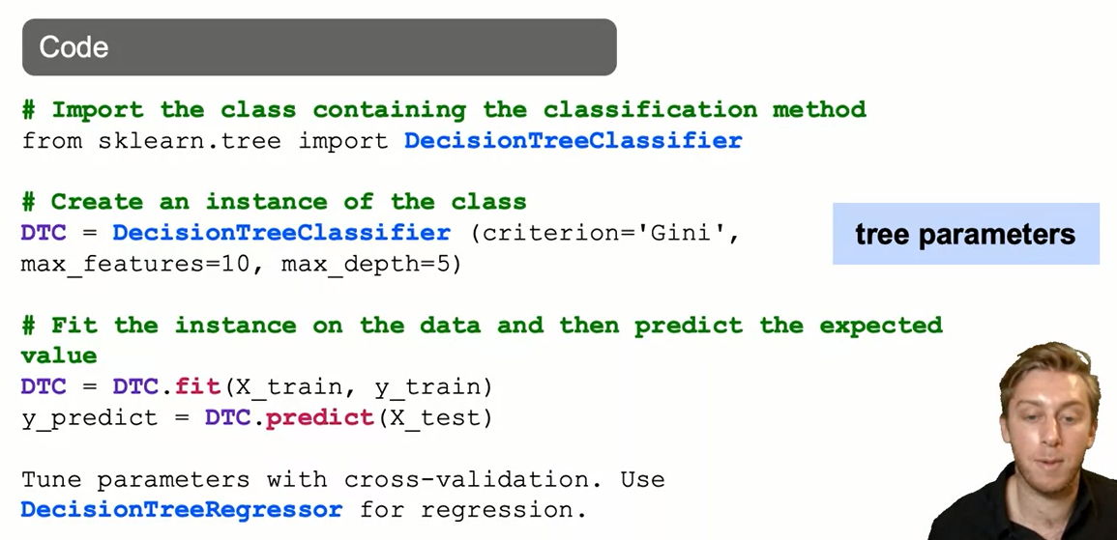
Decision TreeClassifier: The Syntax

Slide 42
Summary
Decision trees split your data using impurity measures. They are a greedy algorithm and are not based on statistical assumptions.
The most common splitting impurity measures are Entropy and Gini index. Decision trees tend to overfit and to be very sensitive to different data.
Cross validation and pruning sometimes help with some of this.
Great advantages of decision trees are that they are really easy to interpret and require no data preprocessing.

Slide 43
Learning Recap
In this section, we discussed:
- Overview of Classification problems
- Decision Tree Classification algorithm
- Splitting Decision Trees: entropy and information gain
- Pruning Decision Trees to address overfitting

